Slide 1
Impact of Hallyu (Korean wave) contents on online platforms to destination branding with the mediating role of user satisfaction
Won Ji Chung
Chul Jeong
Department of Tourism
Hanyang University
CBR 2022, Florida USA 13th – 15th October 2022

Slide 2
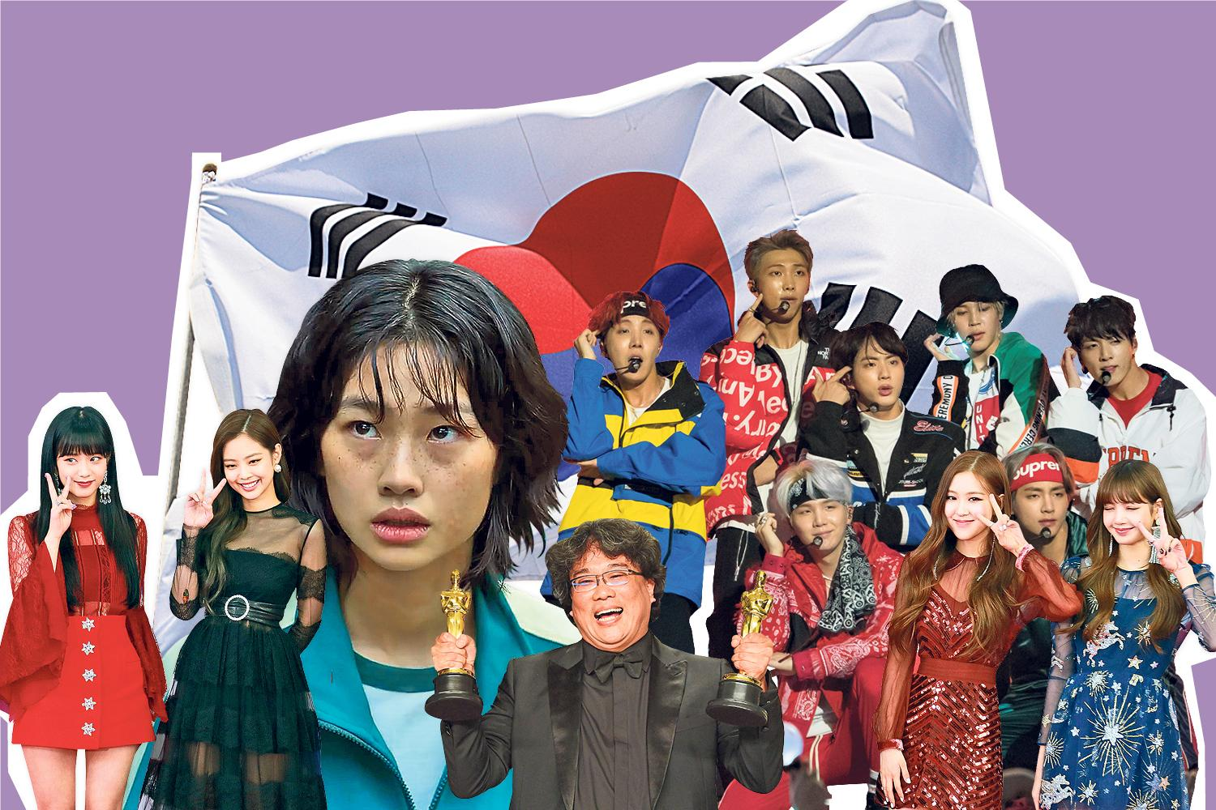
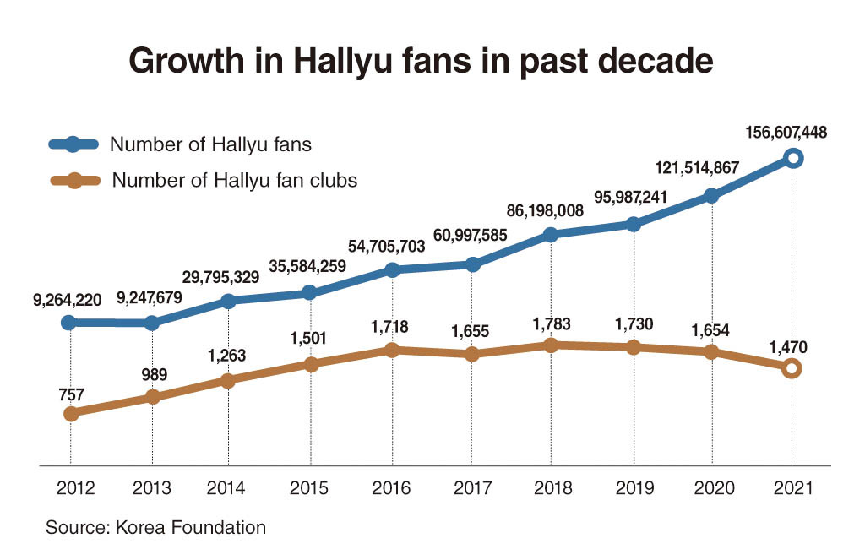
Background
Hallyu represents Korean music, television programs, films, online games, and web-toons
According to a survey published by the Korea Foundation in cooperation, the number of Korean Wave fans recorded 156.6 million as of December last year
Soft Power: the ability to weild global influence simply through appeal and attraction
The early interest started in 1997 when Korean dramas were first broadcast on television in China and Japan
These entertainment products quickly gained popularity among women of age 40-50s
Futher spread of Korean K-pop music gained popularity on radio and in dance venues worldwide

Slide 4
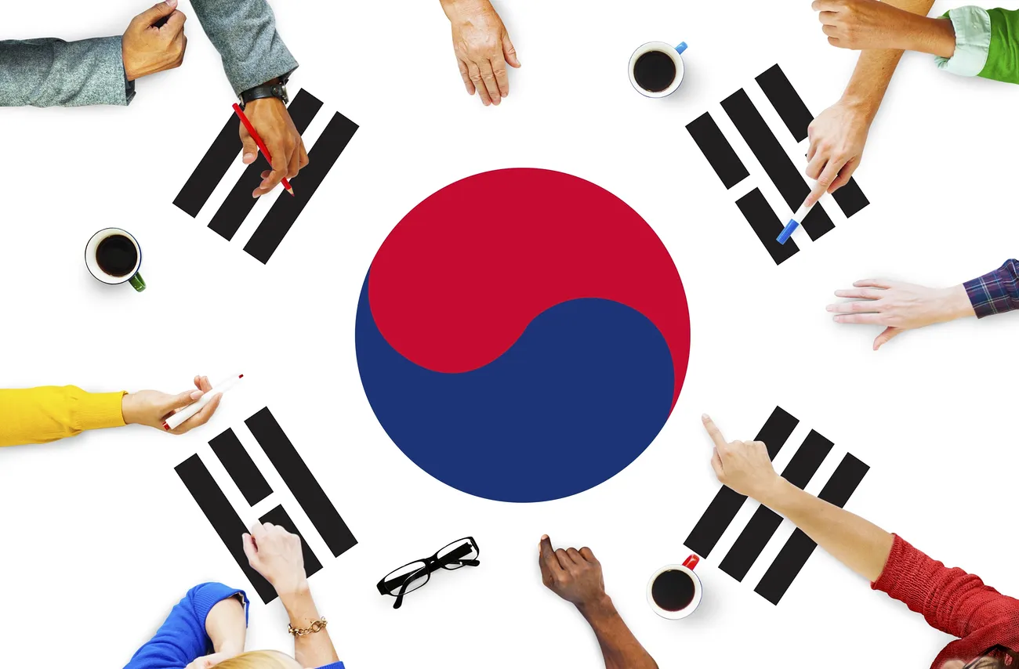
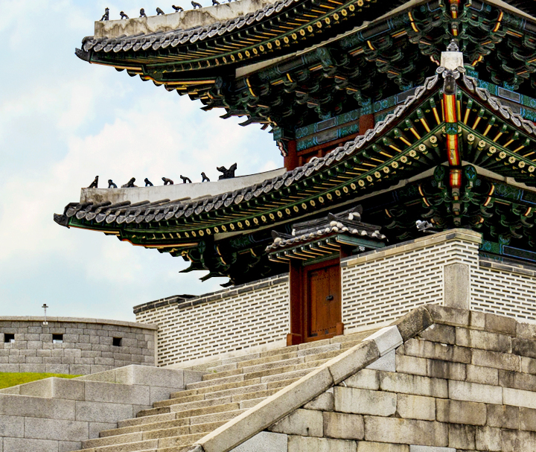
Literature Review
Cultural attractiveness
Attractiveness refers to the possession of desirable qualities by an individual that evoke positive affective evaluations in others (Blau, 1960; Lott & Lott, 1965).
Individuals who display specific traits, characteristics, or behaviours deemed desirable and valuable by an observer evoke positive perceptions in the observer, and thus, becomes attractive in the observer’s eyes (Berscheid and Walster, 1969).
The challenges, negativities, and difficulties that originate from such encounters (Shenkar, 2001; Tung and Verbeke, 2010).

Slide 5
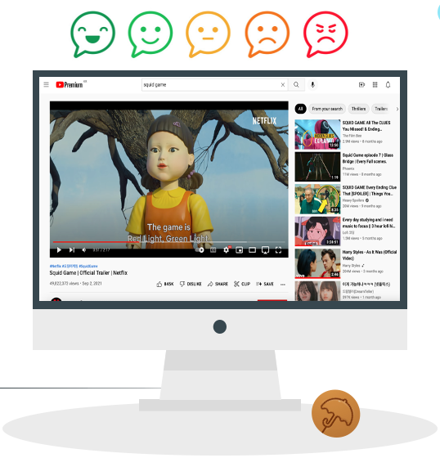
Literature Review
Emotional value
Emotional value relates to a complex instinctive state of feelings when consuming products or services (Bendixen et al., 2004; Sweeney and Soutar 2001)
Based on consumer’s perception of the value-added embedded in overall experience, a multidimensional construct of hedonic dimension creates psychological states that can have an impact on future behavior (Khan and Mohsin, 2017)
In particular, hedonic dimension of emotional value is more subjective and personal than functional value and can better understand consumers’ attitude while attending events for entertainment and fulfillment (Nicholson and Pearce, 2001)

Slide 6
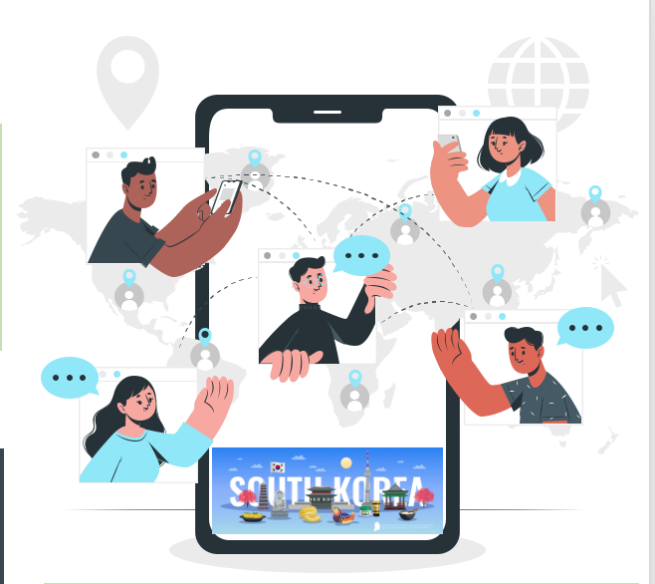
Literature Review
User Engagement
From a simple content viewing of passive observers to users with active interactions are present on social media
Social media platforms engage audience through contents and level of interest (Chu & Kim, 2011)
Attracting user engagement on social media allows people to create an image of a certain product or services (Coursaris, 2016; Khan, 2017)
Participation in the information development results consumer initiation of user behaviour (Hogarth, 1991)
User Satisfaction
The key aspects of social media satisfaction include overall evaluation of information systems and consumer behavior of experience on social media (Au, Ngai & Cheng, 2002)
For entertainment programs, movies, and animations, satisfaction with the quality of the content itself was the most important favourability factor (Hallyu Report, 2021).
Tourism satisfaction effect on general country image, destination image, and post-visit intentions (De Nisco et al., 2015)

Slide 7
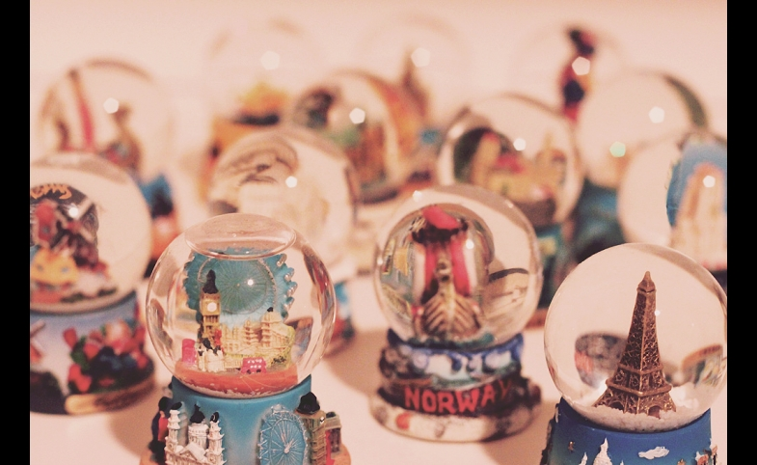
Literature Review
Country Image
The overall of all descriptive, inferential and informational beliefs one holds on a particular country (Martin and Eroglu, 1993)
Hallyu’s impact on Korea’s national image and domestic economy, as well as on transnational cultural flows, have received scholarly attention (Jin & Yoon, 2016; Lee & Nornes, 2015)
However, little discussion of the role of social media in Hallyu’s propagation on the impact of tourism is taken
Destination Image
An image of a place as the sum of all those emotional, and aesthetic qualities such as experience, beliefs, ideas, recollections and impressions, that a person has of a place (Kotler, Haider, & Rein, 1993)
Country image and destination image has impact on tourists’ travel intention (Chaulagain, Wiitala & Fu, 2019)

Slide 8
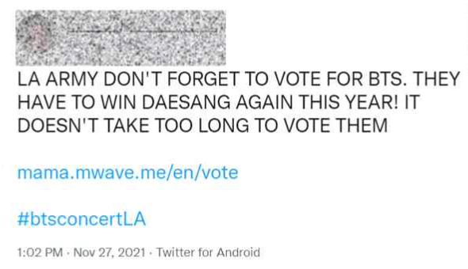
Literature Review
Behavioral Intention
Behavioral intention is deemed as likelihood of revisiting the same destination or other film tourism destinations and recommending the tour to others
In tourism, it is considered as desirable behaviors that tourists anticipate exhibiting in the future (Lee al., 2007)
Intention to revisit a destination and positive word of mouth (WOM) are the most commonly employed indicators for measuring behavioral intentions (Williams and Soutar, 2009; Quet al., 2011)
Celebrities can influence the national image and behavioral intentions
Involvement of Hallyu celebrities in Japan showed that they exerted a cognitive and emotional influence on Korea’s tourist image as well as swayed intention to visit Korea (Lee et al., 2012)

Slide 9
Proposed Research Model
Hallyu content Satisfaction (SA)
Mediator: H12-H17
H1
Hallyu Attractiveness (HA)
H10
H2
Destination Image
(DI)
H4
H3
H5
Emotional Value
(EV)
H11
H6
Visit Intention
(VI)
H7
H8
H9
User Engagement (UE)

Slide 10
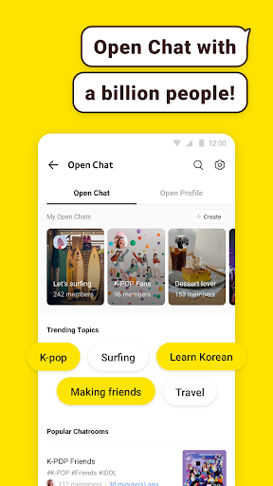
Research Method
01
Data Collection
The survey for this study was conducted from December 2021 to January 2022
Data was collected using self-administered questionnaire distributed electronically using Google form after a through explanation of later uses
The questionnaire applied a 5-point Likert scale (1=strongly disagree to 5=strongly agree)
A total of 230 respondents participated
The final 201 valid responses retained showed 87.4% response rate
02
Analysis Method
Statistics Programme
SPSS25.0: Frequency analysis, Exploratory factor analysis, Reliability analysis
AMOS25.0: Confirmatory factor analysis (CFA)
Statistical Process
Verify Confidence, Verify Validity, Verify a Hypothesis
Two-stage testing procedure was adopted by using AMOS 25.0
(Hair et al., 2010; Anderson & Gerbing, 1988)

Slide 11
Findings- Demographic Characteristics of the Respondents
Characteristics |  | Sample | % | Characteristics |  | Sample |  | %
Gender | Female Male | 110 107 | 50.1 49.9 | Marital status | Single Married |  | 212 5 |  | 97.7 2.3
Occupation | Student Homemaker Service worker Office worker Self employed Civil servant Professional | 163 1 12 16 12 1 12 | 75.1 .5 5.5 7.4 5.5 .5 5.5
 |  |  |  | Education | High school or less Highschool diploma Some college, no degree University Graduate School |  | 44 67 35 66 5 |  | 20.3 30.9 16.1 30.4 2.3
 |  |  |  | Age | Less than 18 years 18 ~ 29 30 ~ 39 Over 40 years |  | 57 143 16 1 |  | 26.3 65.9 7.4 .5
Total |  | 217 | 100 | Total |  |  | 217 |  | 100

Slide 12
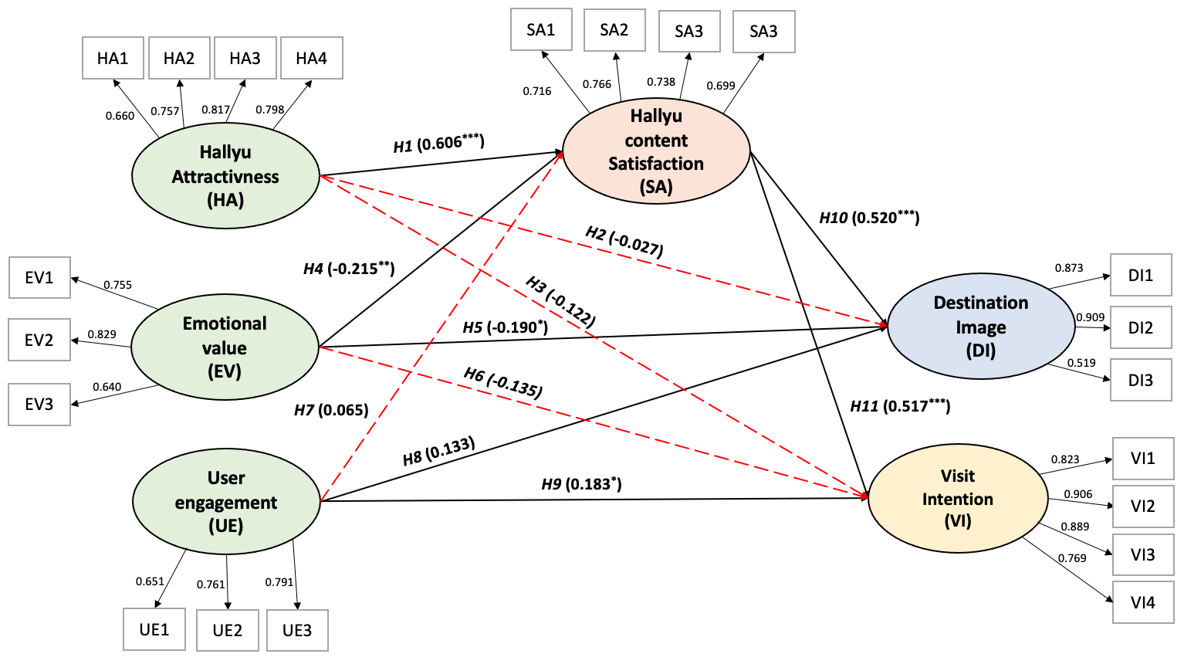
Findings- Structural Model and Path Coefficients
Notes: * p < 0.05, ** p < 0.01, *** p < 0.001
Dotted lines indicate insignificant paths

Slide 13
Limitations and Conclusion
Limited dimension of the sample
Limited to quantitative research method
The impact of engagement was not supported
Revision of the items of the variable on engagement is required
Qualitative: Netnography
Big Data research: sentiment analysis, text mining
Select and test the model in 3-5 nations and with bigger sample
Notes:
Information Exchange & Brand Love are the most important factors of engagement.
Collective Self-Esteem is very important

